Slide 1
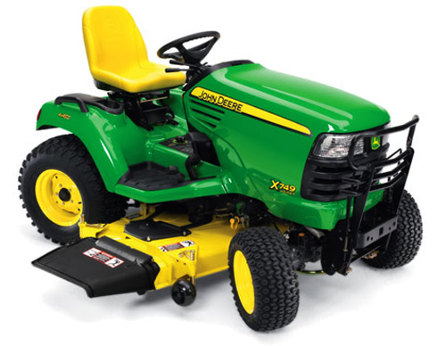
Horticultural Careers
Americans spent $100 billion yearly on horticulture – there is money to be made!
Average money spent on:
Lawn care $220
Landscaping $174
Tree care $97
Flower gardening $88
Insect control $60
Vegetable gardening $58
Indoor houseplants $40

Slide 2
TOP WI Post-Secondary Plant-Related Universities
2 year programs
NWTC
FVTC
MATC/UW-Madison Short Course
4 year programs
UW-River Falls
UW-Platteville
UW-Madison

Slide 3
Botany Careers Videos
Agronomy
http://www.youtube.com/watch?v=L7yWnvTNcGc
http://www.youtube.com/watch?v=2tsx7er7Cnw
Horticulture
http://www.youtube.com/watch?v=2I94O96OJNU
http://www.youtube.com/watch?v=XdFWggcIqFc
http://www.youtube.com/watch?v=AZCkcJTjhVU

Slide 4
Activity
Complete the Self-Evaluation for Chapter 1 in your textbook on pages 11 and 12.
Most questions you will be able to answer from our discussion, for some you may need to go back and read parts of chapter 1.
Complete in notebook – label appropriately
Work with a partner/clock buddy – share books
If you finish early you can start reading chapter 2

