Slide 1
Candy Stages
As a sugar syrup is cooked, water boils away, the sugar concentration increases, & the temperature rises.
The highest temperature that the sugar syrup reaches tells you what the syrup will be like when it cools.
That’s how stages are named.

Slide 2
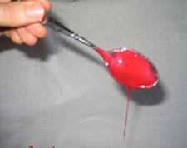
Thread Stage
When a teaspoon is dipped into the hot mixture & lifted out, the candy falls off the spoon in a long thread
230 F – 233 F

Slide 3
Cold-Water Test
All of the following stages can be tested with the cold-water test
Spoon a few drops of the hot candy mixture into a cup of cold water
Using your fingers attempt to form into ball, then remove from water
The firmness of the ball will correspond to one of the following stages & temperatures

Slide 4
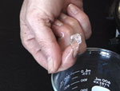
Soft-ball Stage
When the ball of candy is removed from the cold water, it instantly flattens & runs off your fingers
244 F – 248 F
Sugar concentration – 85%

Slide 5
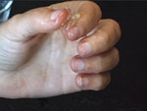
Firm-ball Stage
When the ball of candy is removed from cold water, it is firm enough to hold its shape but quickly flattens
245 F – 250 F
Sugar Concentration = 87%

Slide 6
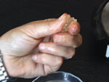
Hard-ball Stage
When the ball of the candy is removed from the cold water, it holds its shape but can be deformed with pressure
250 F – 266 F
Sugar Concentration = 92%

Slide 7
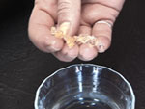
Soft-Crack Stage
When the hot mixture is dropped into the cold water, it separates into hard, pliable threads that cannot be shaped into a ball
270 F – 290 F
Sugar Concentration = 95%

Slide 8
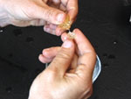
Hard-Crack Stage
When the hot mixture is dropped into cold water it separates into hard brittle threads that snap easily & cannot be shaped into a ball
295 F – 310 F
Sugar Concentration = 99%

